Slide 1
Chapter 22
The Ordeal of Reconstruction,
1865-1877

Slide 2
What is Reconstruction?
Attempt to achieve national reunification and reconciliation after the Civil War and to improve the status of former slaves (freedmen).
Major questions of Reconstruction:
How should states and leaders be handled? Punished? Forgiven? Somewhere in between?
President Johnson pardoned most rebel leaders

Slide 3
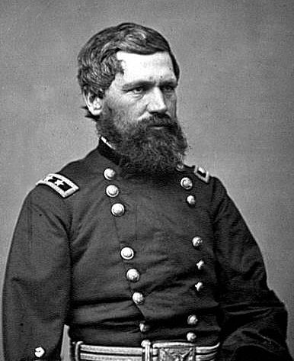
**The Freedmen’s Bureau**
Created by Congress on March 3, 1865
Purpose was to help unskilled, uneducated, poverty-stricken, ex-slaves and poor-whites survive
Headed by Union General Oliver O. Howard
Authorized forty acres of confiscated land to former slaves, rarely happened though
Most success was in EDUCATION

Slide 4
Different Views of Reconstruction
1863, Lincoln proclaimed his “10 %” plan
If 10% of voters in 1860 election pledge loyalty to US and abide by emancipation, state could be readmitted
Very forgiving plan
Wade-Davis Bill:
Required 50% of voters to take oath of allegiance before readmission
“Pocket-vetoed” by Lincoln
Johnson’s Plan:
Similar to Lincoln’s plan, recognized “10%” governments, called for states to ratify 13th amendment

Slide 5
The Black Codes
Designed to regulate the affairs of the emancipated Blacks
Way to keep former slaves down and keep a steady labor supply
Many Blacks signed contracts to work for low wages for same employer for 1 year
Penalties for “jumping” contracts, bounty hunters to catch jumpers
Other aspects of codes:
Blacks couldn’t serve on a jury or vote
Many former slaves were forced to become “Share-croppers”
Tenants are allowed to use land in exchange for giving percentage of crops to owner

Slide 6
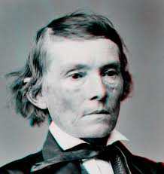
Congressional Reconstruction
Many Southern confederates were now in office (Including former VP as Senator of GA). This infuriates Republicans, call for harsh treatment of South……

Slide 7
Johnson clashes with Congress
No more political office for me!
Civil Rights Bill (1865): (Vetoed by Johnson)
Gave Blacks citizenship and aimed to destroy Black Codes
14th amendment: (passed to make sure Civil Rights Bill could not be overturned)
Grants citizenship to Blacks (and all born in US)
Former Confederate office holders could not hold state or federal office
Reduced Electoral representation to those states that deny Blacks the right to vote

Slide 8
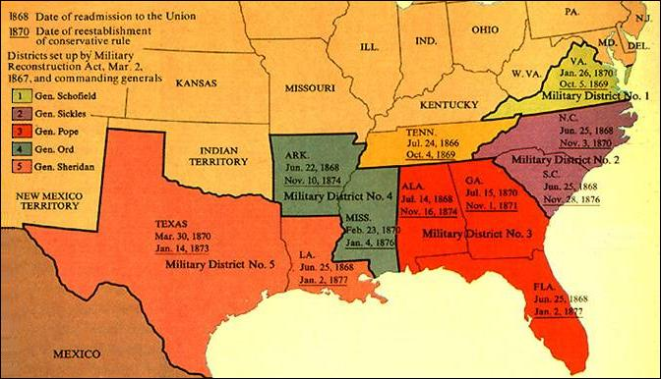
Military Reconstruction
Reconstruction Act (March 2, 1867):
Divided the South into 5 military zones controlled by Union generals
Congressional requirements for readmission:
Seceded states must ratify 14th amendment
Guarantee suffrage to former adult male slaves in state constitutions
15th amendment: Suffrage for Blacks
No mention of holding office
No suffrage for women

Slide 9
Memory Aid for 13 - 15
Free, Citizens, Vote
13th = freedom
14th = citizenship granted
15th = universal male suffrage
Thanks Mr. Hughes
HipHughes

Slide 10
Key Reconstruction Terms
Scalawag:
Southerners that favored the North and supported Reconstruction
Carpet Bagger:
Northerners who moved to the South in order to gain power and profit
KKK
Purpose was to prevent blacks from voting and intimidate whites that supported blacks voting
Did so by flogging, mutilating, and murdering
Force Acts of 1870 and 1871:
Federal troops were sent to quell the KKK’s intimidation
Literacy tests was another way to prevent blacks from voting

Slide 11
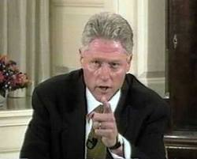
Johnson is Impeached
1st President to be impeached
Only one other one has been impeached. Who? Why?
Tenure of Office Act
Passed by Congress requiring Senate to approve removal of cabinet member
Congress knew Johnson would violate law, when he did House impeached him
By margin of 1 vote, Johnson is not removed

Slide 12
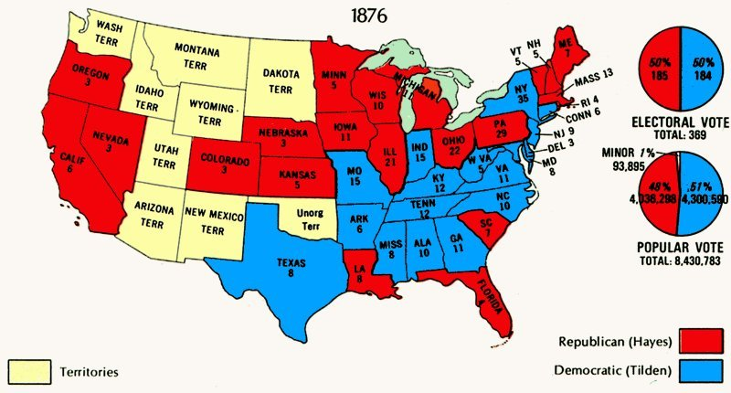
End of Reconstruction….
Compromise of 1877 ends Reconstruction…..
Chapter 23, WICKED Important

Slide 13
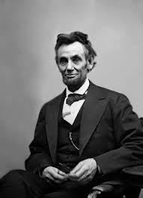
That’s it!
Subscribe to APUSHReview.com
Help spread the word
Questions? Comments? Ideas for videos?
Email or leave in comments
4 Score and 7 Years ago, APUSH students subscribed to this channel……

